Slide 1
Computer Graphics (L09)
EG678EX
3-D Transformations
Prepared By: Dipesh Gautam

Slide 2
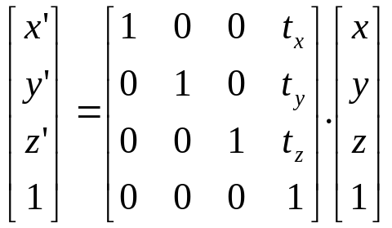

Translation
x’ = x + t_{x}
y’ = y + t_{y}
z’= z + t_{z}
Prepared By: Dipesh Gautam

Slide 3
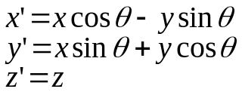
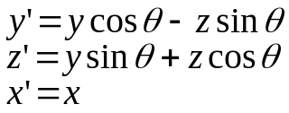
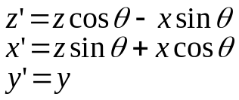
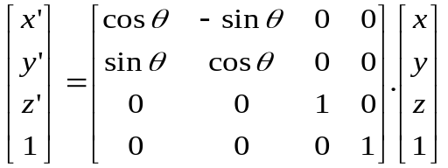
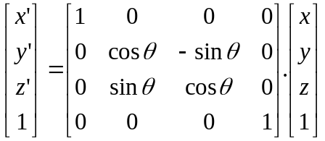
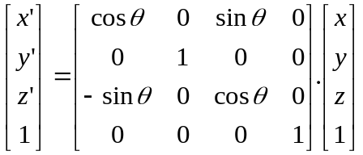



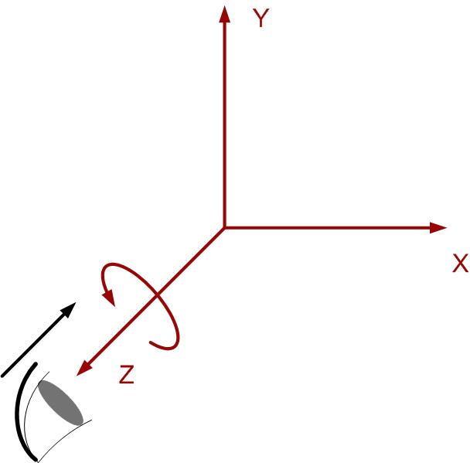
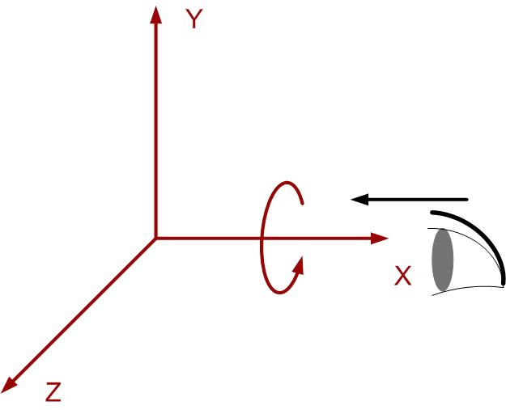
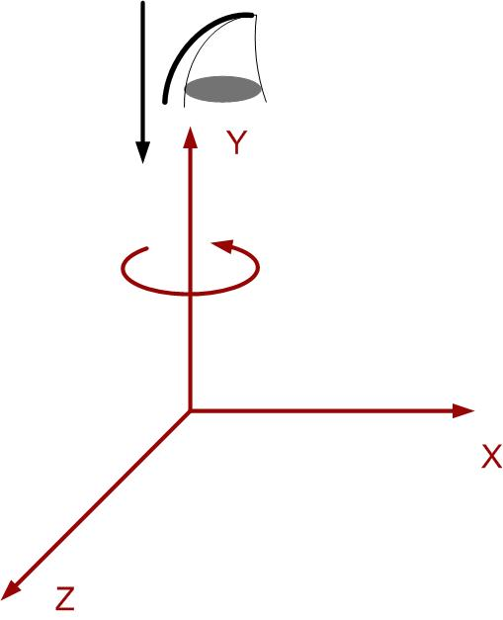

Rotation (about co-ordinate axes)
Remember The cyclic order:
Prepared By: Dipesh Gautam

Slide 4
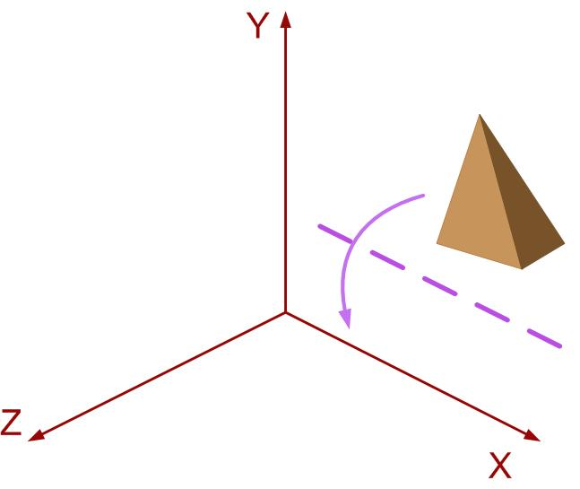
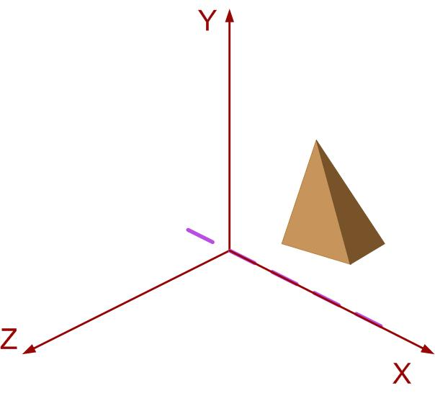
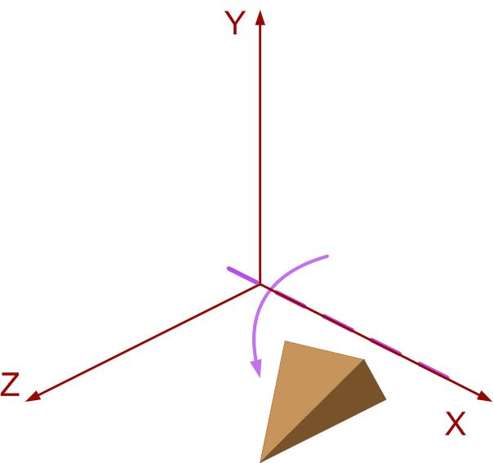
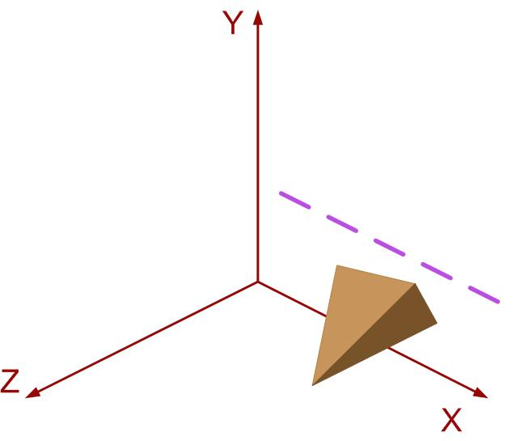
Rotation about axis parallel to co-ordinate axis
Steps
Translate the object so as to coincide rotation axis to parallel co-ordinate axis
Perform the rotation about the axis
Translate back the object so as to move rotation axis to original position
x
Step 1
Step 3
Step 2
Prepared By: Dipesh Gautam

Slide 5
General 3D Rotation
Prepared By: Dipesh Gautam

Slide 6
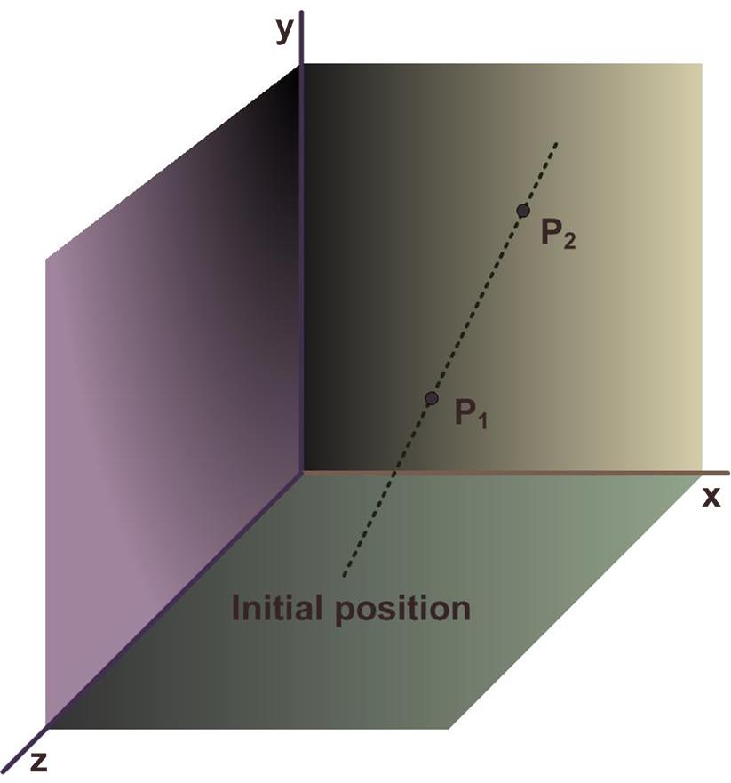
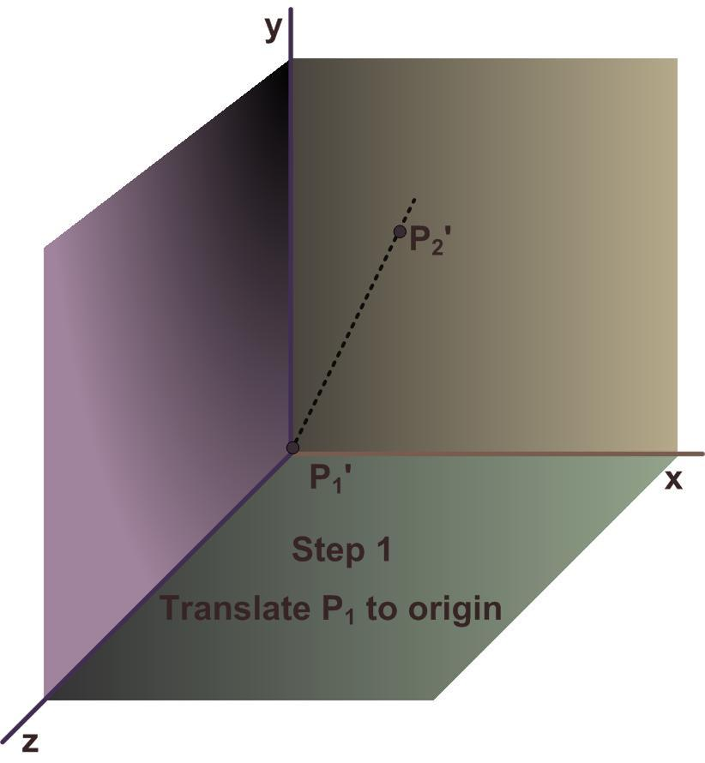
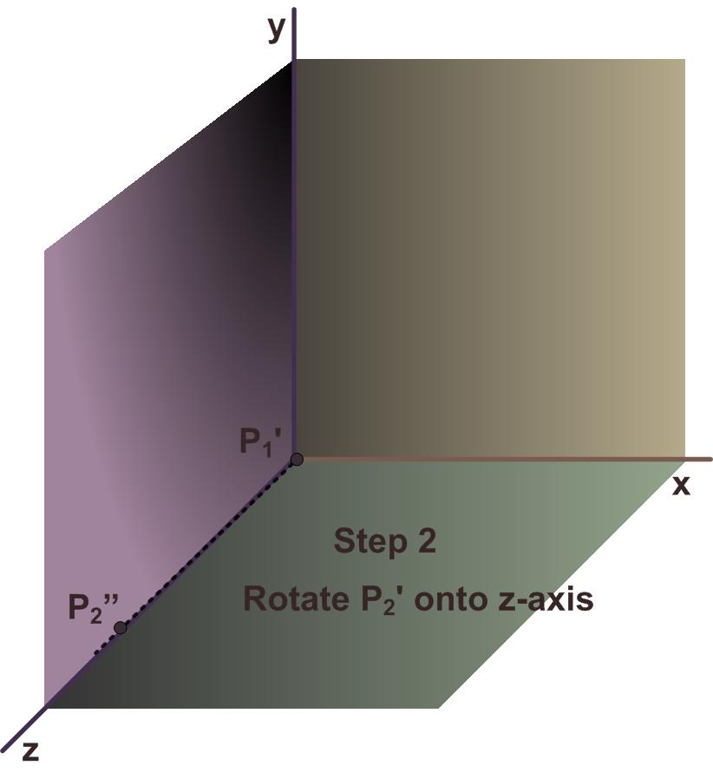

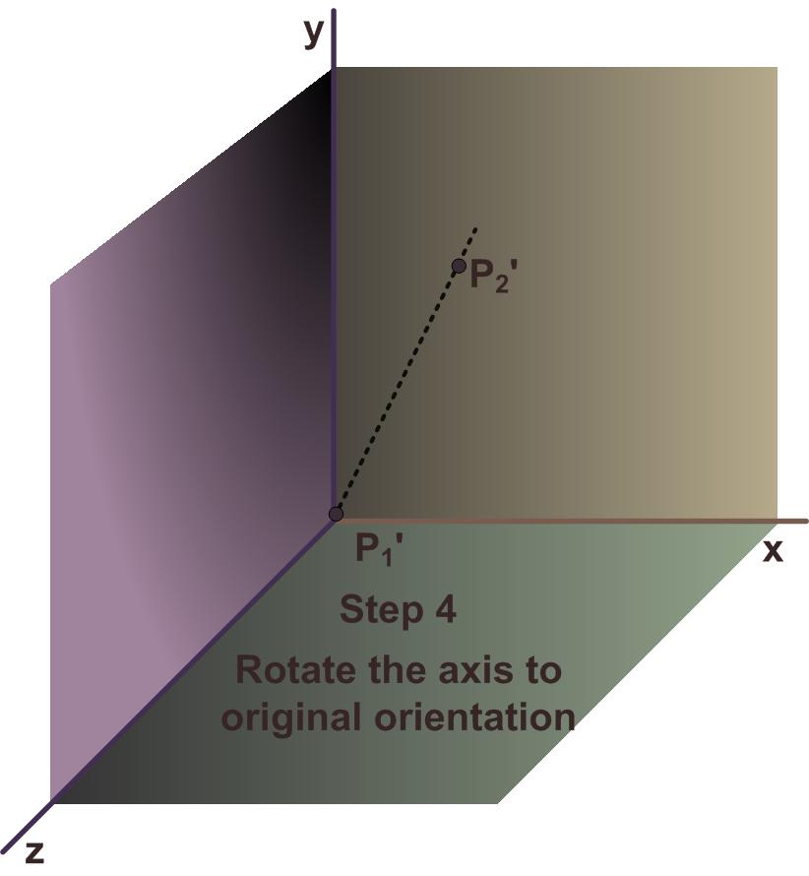
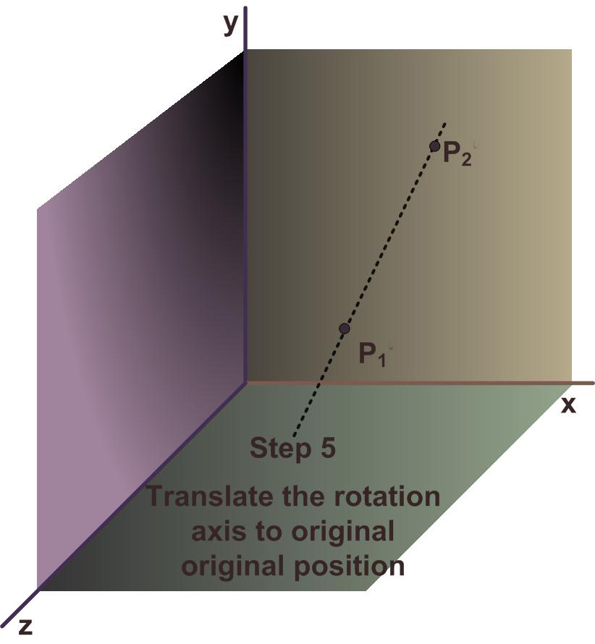
General 3-D Rotation
Prepared By: Dipesh Gautam

Slide 7
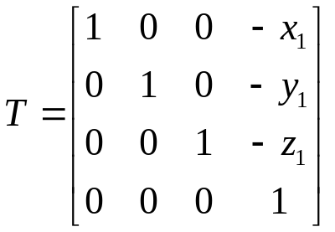
General 3-D rotation Mathematics
Step 1
Translate object so as to coincide P₁ to origin
Prepared By: Dipesh Gautam

Slide 8

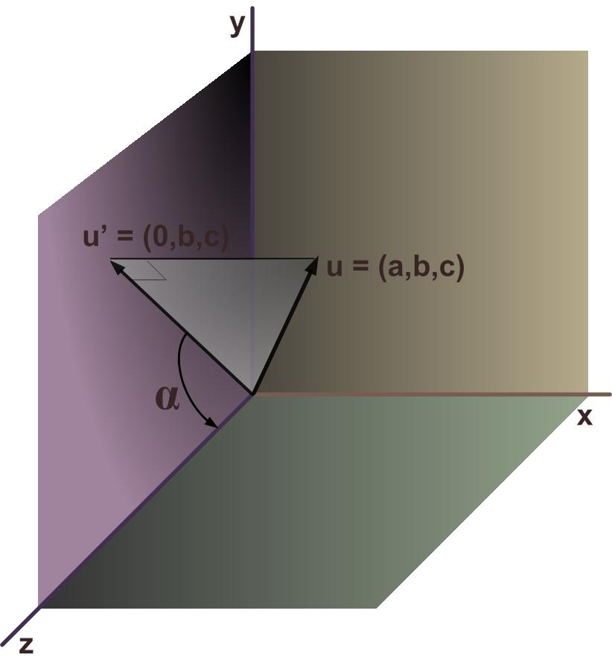



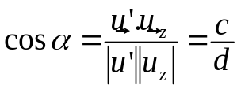

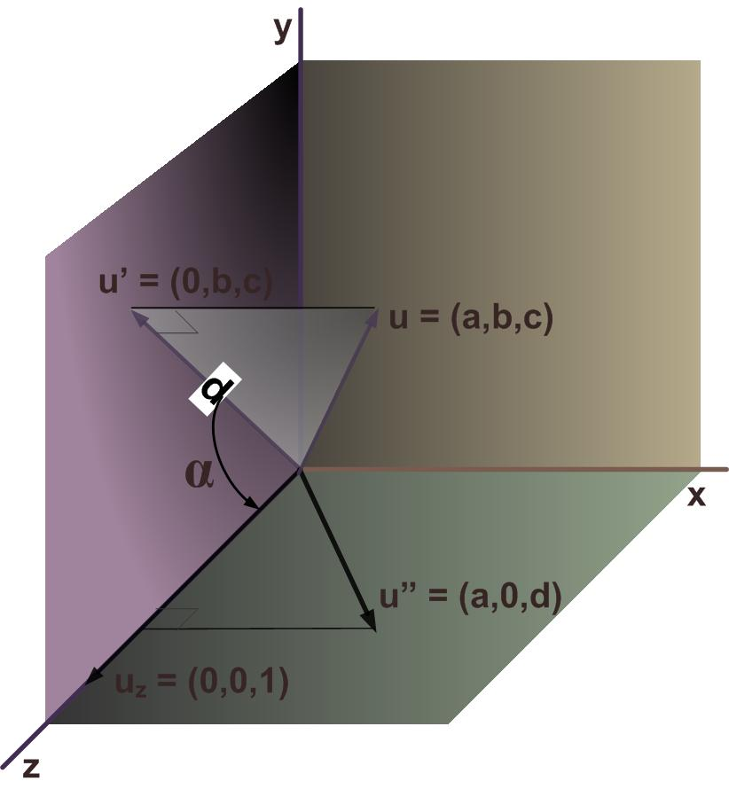



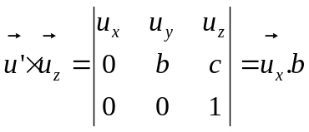
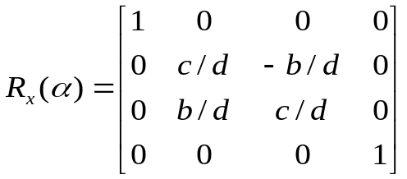
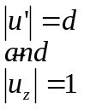
General 3-D Rotation
Mathematics
X- Axix rotation (α)
Step 2
Accomplished in two steps
Perform x axis rotation with angle α so as to bring rotation axis to zx plane
Perform y axis rotation with angle ß so as to coincide the rotation axis with z-axis
Prepared By: Dipesh Gautam

Slide 9
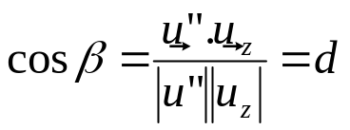


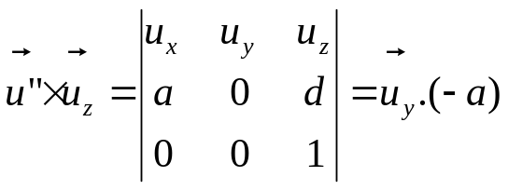
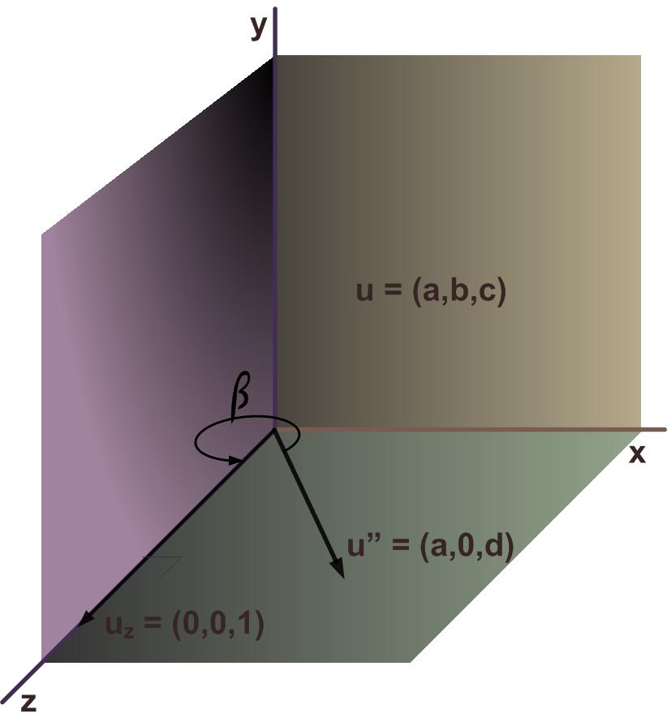
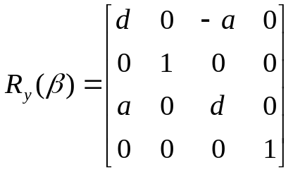
General 3-D Rotation
Mathematics
Y-Axis Rotation (ß)
Prepared By: Dipesh Gautam

Slide 10
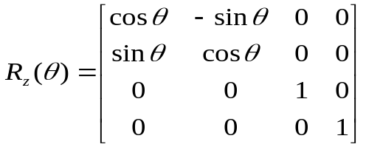
General 3-D Rotation Mathematics
Step 3
Perform z-axis Rotation with angle θ (the angle which the object is to be rotated about the given axis)
Step 4
Perform inverse Rotation and i.e R_{x}⁻¹(α) and R_{y}⁻¹(ß)
Step 5
Perform inverse Translation i.e T⁻¹
Final composite Matrix is obtained as:
Prepared By: Dipesh Gautam

Slide 11
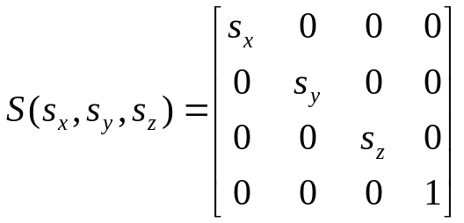
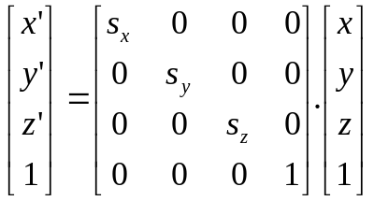
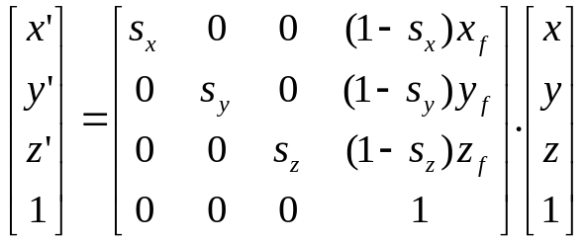
3-D Scaling
Scaling about origin
Fixed Point Scaling
Prepared By: Dipesh Gautam

Slide 12
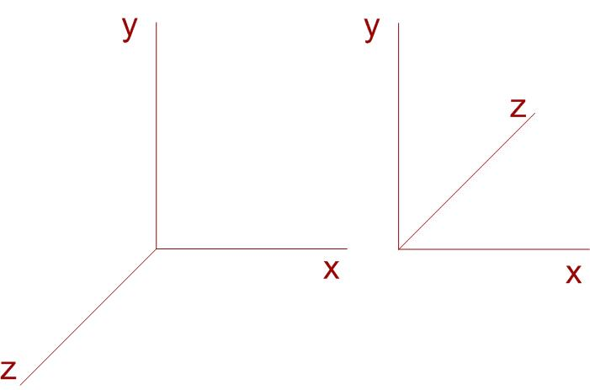
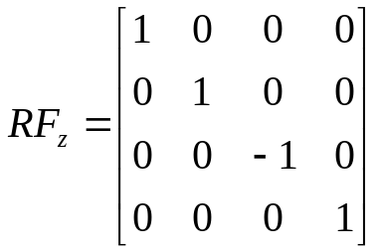
3-D Reflection
Performed relative to a reflection axis or reflection plane
Axis reflection→ equivalent to 180 degree rotation about the axis in 3-D space
Plane reflection → equivalent to 180 degree rotation in 4-D space
  4-D space ?? → not visualized in euclidian space
Reflection about a plane converts right handed co-ordinate system to left handed co-ordinate system and vice versa
Reflection in xy plane
      x’ = x
      y’ = y
      z’ = -z
  Matrix is as
Prepared By: Dipesh Gautam

Slide 13
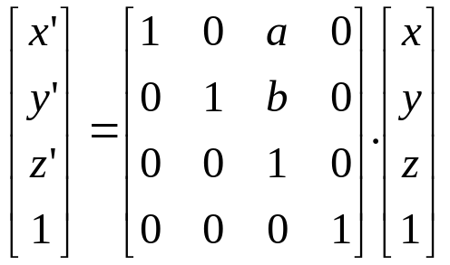
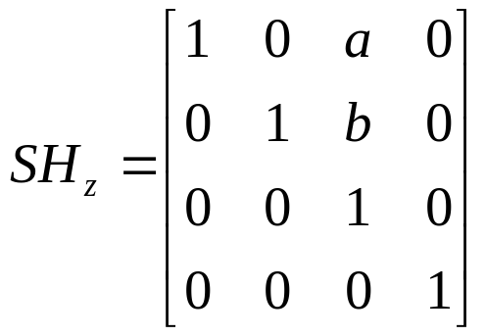
3-D Shear
Z-axis shear
    x’ = x + a.z
    y’ = y + b.z
    z’ = z
Prepared By: Dipesh Gautam

